Slide 1
FINANCIAL OFFICER GUIDELINES
Lutheran Women in Mission
Valuable Information for Financial Officers
Presented by Anita Werner, Treasurer

Slide 2
Qualities
Familiarity with bylaws, policies & procedures, and LWML Financial Officer Guidelines
Detail-oriented with a vision for the long term
Clear and methodical record-keeping
Possess teamwork spirit
Transparent and guided by LCMS beliefs
Understanding of nonprofit status
Heart for Lutheran Women in Mission
Financial Officer Guidelines | November 2024

Slide 3
In this Presentation
Here’s what we’ll cover:
Nonprofit Status
Opening a Bank Account
Records Retention
Risk Management
Mite Offerings
Payments to National Organization
Legacy Gifts

Slide 4
NONPROFIT STATUS

Slide 5
Nonprofit Status
LWML National-Parent Organization is a 501(c)(3).
Districts are subordinates of parent non-profit.
Districts are separate legal entities.

Slide 6
Employer Identification Number (EIN)
LWML National EIN may not be used by any district or other unit of the LWML.
DISTRICTS
Own EIN assigned
Can be found in Financial Officer Guidelines
ZONES & GROUPS
Use EIN of their District
SOCIAL SECURITY NUMBERS
NEVER use a Social Security Number

Slide 7
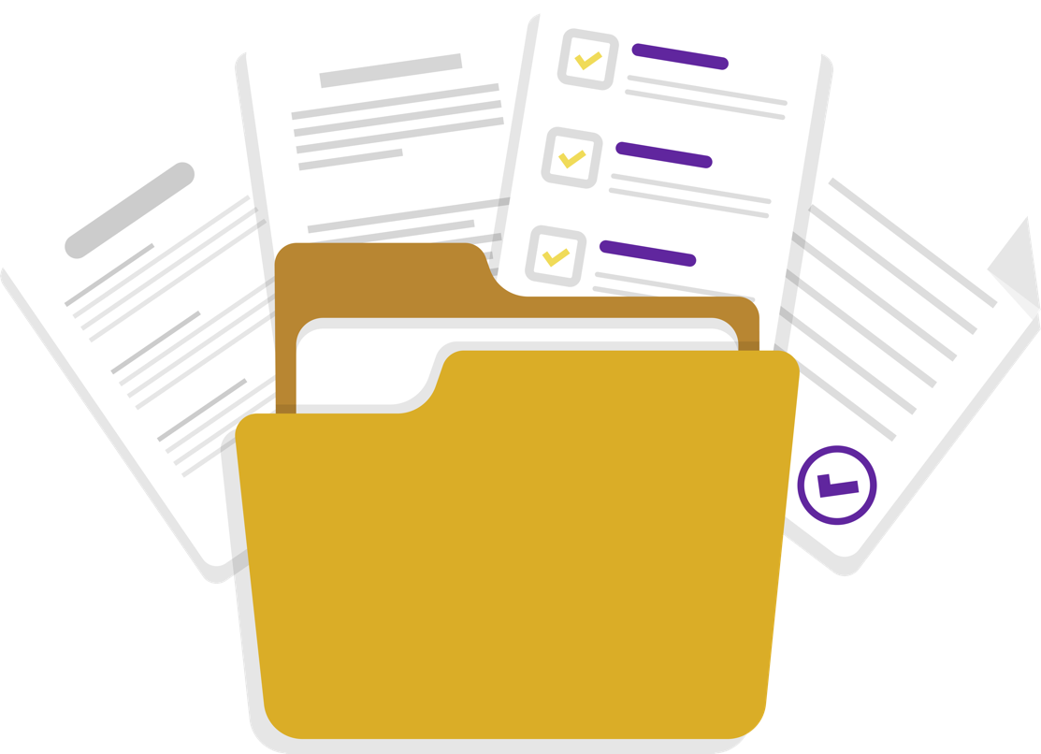
IRS Communications
All communications from the Internal Revenue Service should be maintained in
a PERMANENT file.

Slide 8
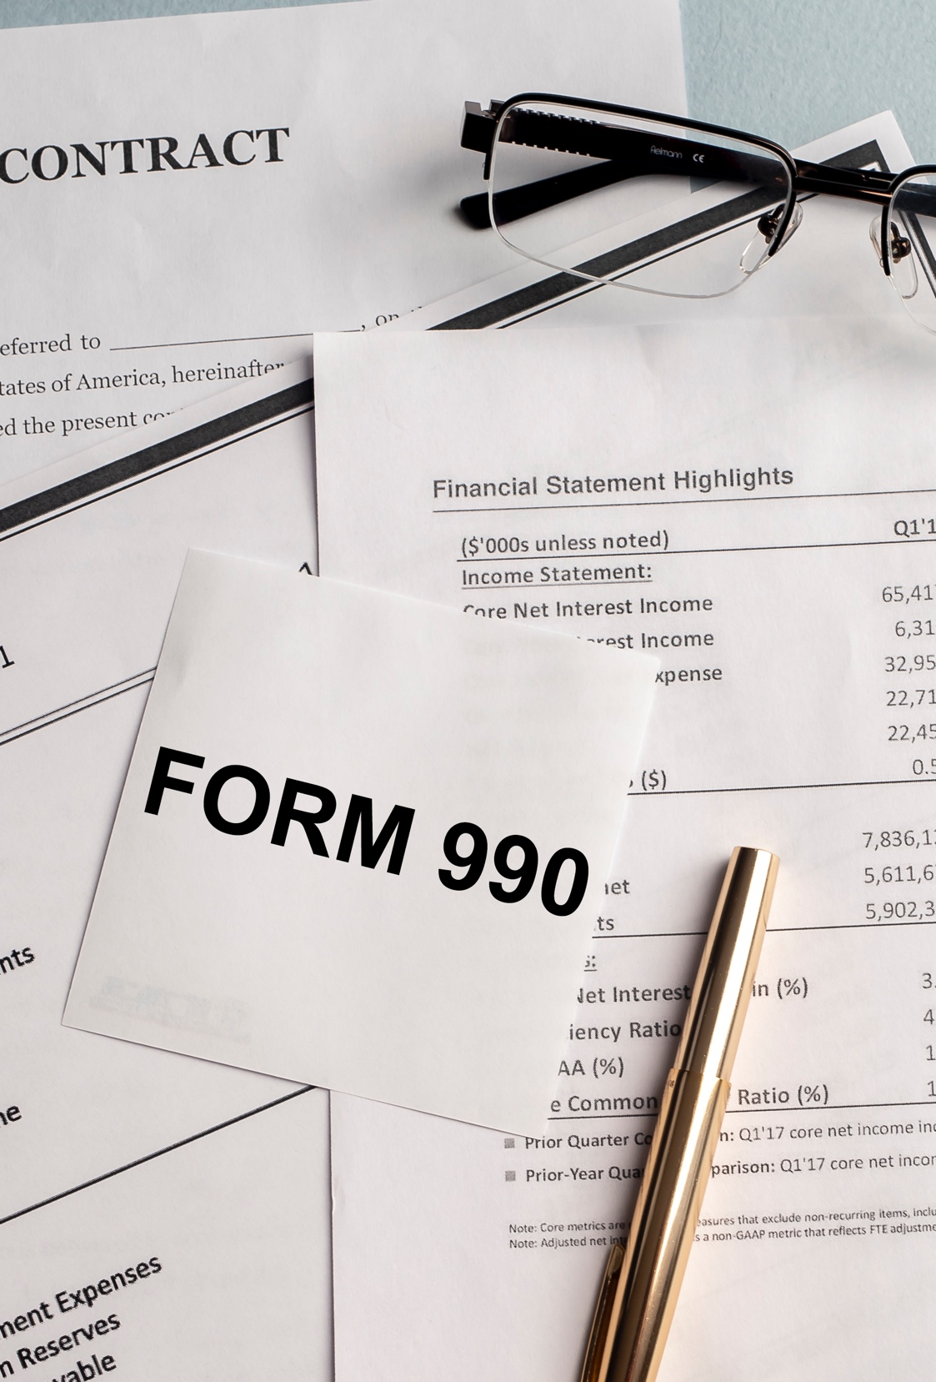
IRS Form 990
LWML and its Districts are Exempt from filing Form 990
Requests from IRS to complete Form 990 or 990-N
Don’t complete the form.
Return form to IRS (blank).
Attach letter stating:
As an integrated church auxiliary, we are exempt from filing the 990 form.
Financial Officer Guidelines | November 2024

Slide 9
Tax Exempt Organization Risks
LWML at risk of losing tax exempt status or incurring costly sanctions if any of these activities occur:
Private benefit (inurement) or interest
Influencing legislation (substantial lobbying)
Campaigning for candidates
Illegal activity

Slide 10
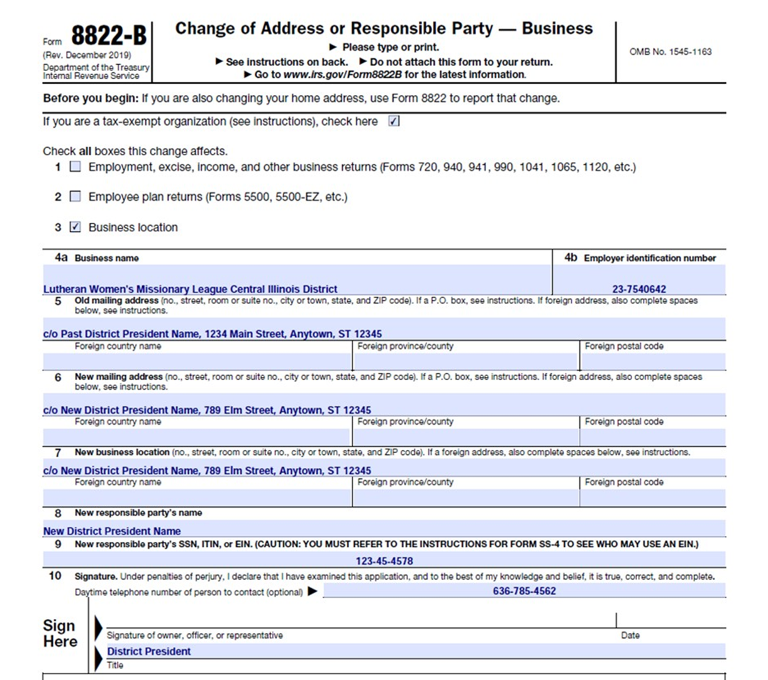
Form 8822-B for District Presidents
District President is official contact for each LWML District.
Upon election, new DP must file Form 8822-B with IRS within 60 days of taking office (providing name and address).
New DP should also provide a copy of Form 8822-B to the LWML Office.

Slide 11
OPENING A BANK ACCOUNT

Slide 12
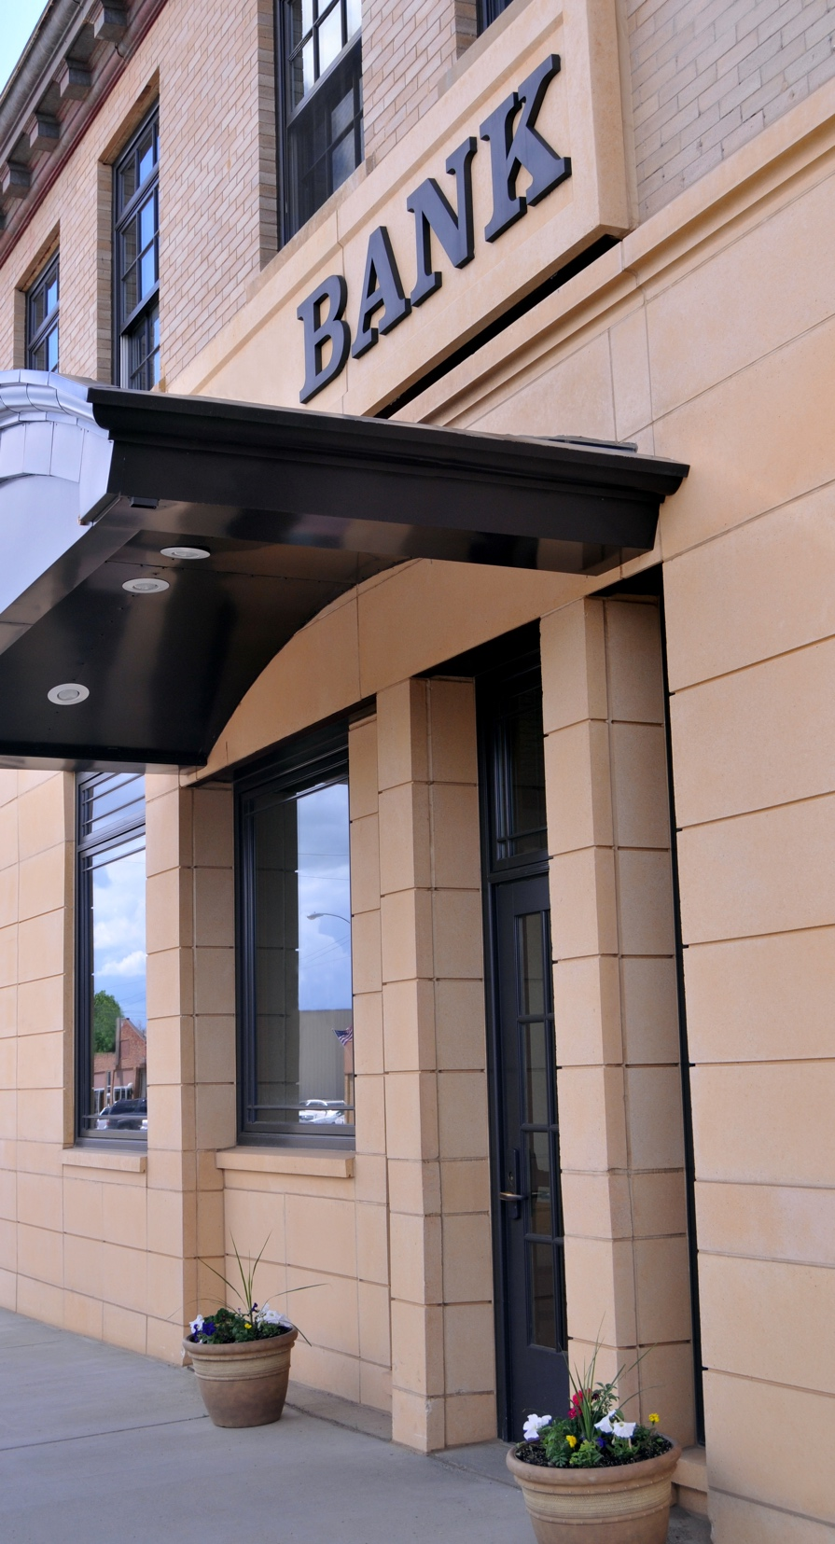
Establishing a Bank Account
Consult your bylaws for rules governing checks and checking/ savings accounts for your district, zone, or group.
Note: As a signer on the account, the bank will require certain personal information to verify your identity.
Financial Officer Guidelines | November 2024

Slide 13
Never open a bank account using the LWML national organization Employer Identification (EIN).
Never use your personal bank account for LWML business.
Never open an account in your name with LWML funds.
Never establish a line of credit.

Slide 14
Financial Institution Comparison
Bank
More advanced mobile apps and technology
Provides more branches and ATM’s nationwide
Community or Regional Banks vs. National Banks
Credit Union
Less options than banks
Thousands of shared Co-op branch locations and surcharge free ATM’s
Lower fees and better interest rates on savings accounts

Slide 15
Another Option
Part of a Co-op network of shared branches nationwide.
Call LFCU to find location of shared branches in your area.
Account opening and changes all completed online with electronic signatures.
May be a feasible banking option for everyone.

Slide 16
Important Guidelines for Zones & Groups
LWML ZONES: Accounts should include both district and zone names.
(e.g., LWML Missouri District-Central Zone)
LWML GROUPS
Accounts should include both district and group names.
(e.g., LWML Missouri District-Trinity Evening Guild)
EIN USE
Use your district’s Employer Identification Number (EIN) to set up the account. (You will need to reach out to your district for a completed W-9 Form.)

Slide 17
W-9 Form for Districts
All districts complete W-9 Form using official contact information (see Financial Officer Guidelines).
Download current form from the irs.gov website.

Slide 18
W-9 Form for Zones and Groups
Zones and groups obtain a current W-9 Form from their LWML District — not LCMS District.

Slide 19
Important Guidelines for Zones & Groups
Account address should be the address of the zone/group financial officer who will receive account statements.
No address should be printed on checks unless required.
Set-up account with at least two authorized signers, but typically only one signature is required on disbursements unless your zone/group has specific requirements.
If required, obtain Letter of Authorization from your district. See Financial Officer Guidelines.

Slide 20
How to verify your LWML district is a nonprofit?
Each LWML district is a separate nonprofit organization under the IRS group exemption.
Central organization is LWML headquarters in St. Louis who holds the group exemption.
Subordinates are the individual LWML districts.
Contact the LWML Treasurer for a letter verifying your district is a member of LWML’s Section 501 (c)(3) group exemption ruling.

Slide 21
RECORDS RETENTION AKA RECORDS MANAGEMENT

Slide 22
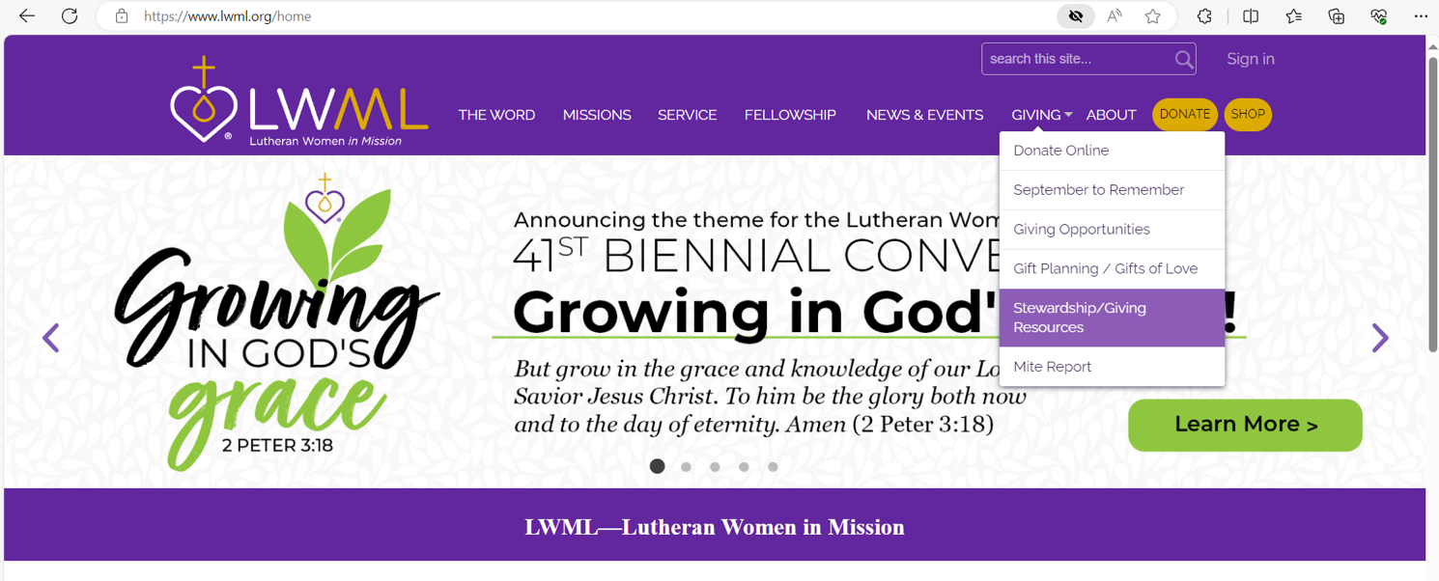
Where to Find Records Mgmt. Policy

Slide 23
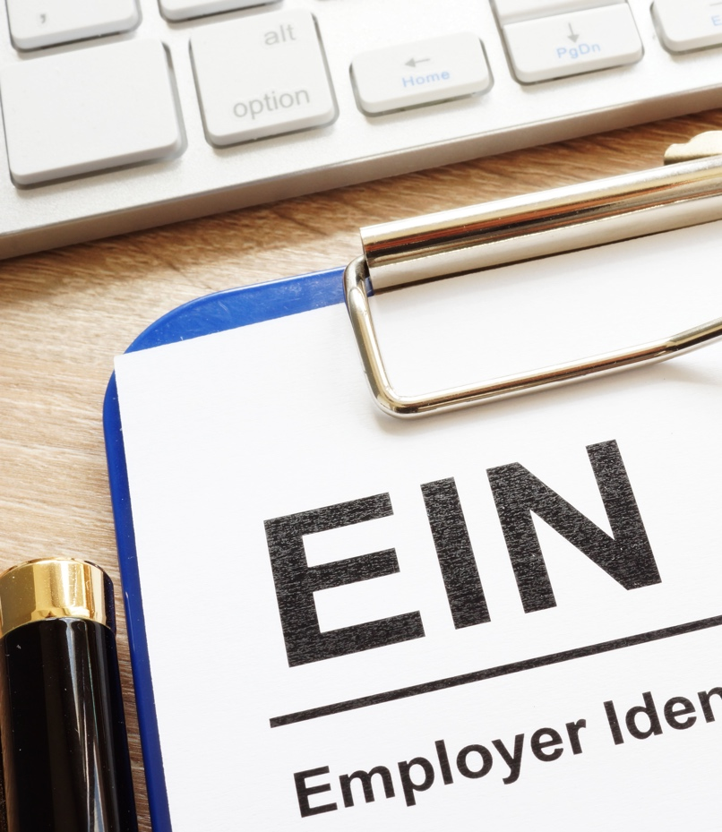
Employer Identification Number (EIN)
EIN aka Tax ID Number is specific to each district
IRS confirmation of EIN Issuance (IRS Form CP 575)
If original is no longer in your files, you can request an “IRS Verification of EIN Issuance” letter (IRS 147c form letter).
Call IRS Business & Specialty Tax Line at 800-829-4933 to request verification letter if needed.

Slide 24
Also Note!
Retain any letter from the IRS stating your district meets the IRS Section 501(c)(3) requirements of exemption.
For a letter verifying your district is a member of LWML’s 501 (c) (3) group exemption ruling, contact the LWML Treasurer (Anita Werner).

Slide 25
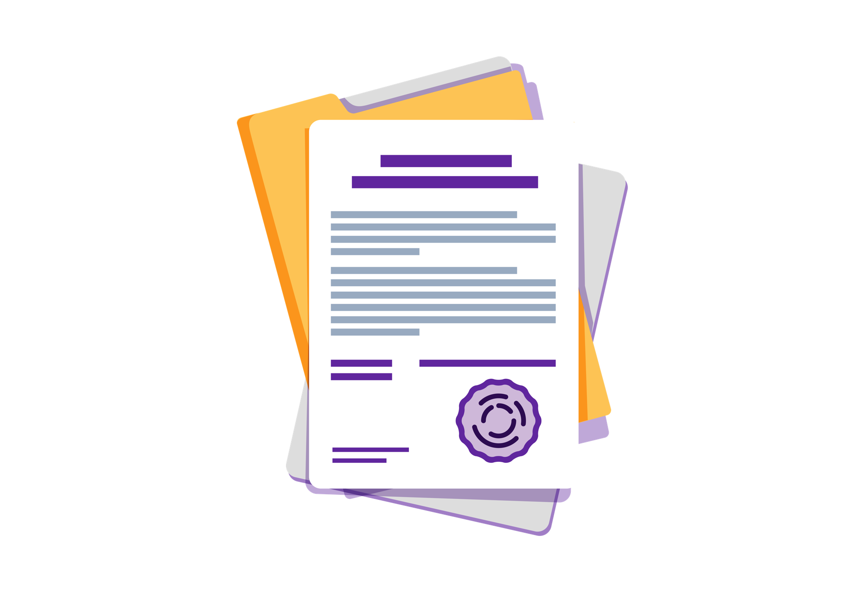
Also Keep!
Articles of Incorporation for your district filed with your state
Registration and/or incorporation documents from your state
May include a copy of certificate of good standing from your Secretary of State
Current set of bylaws with most recent approval date

Slide 26
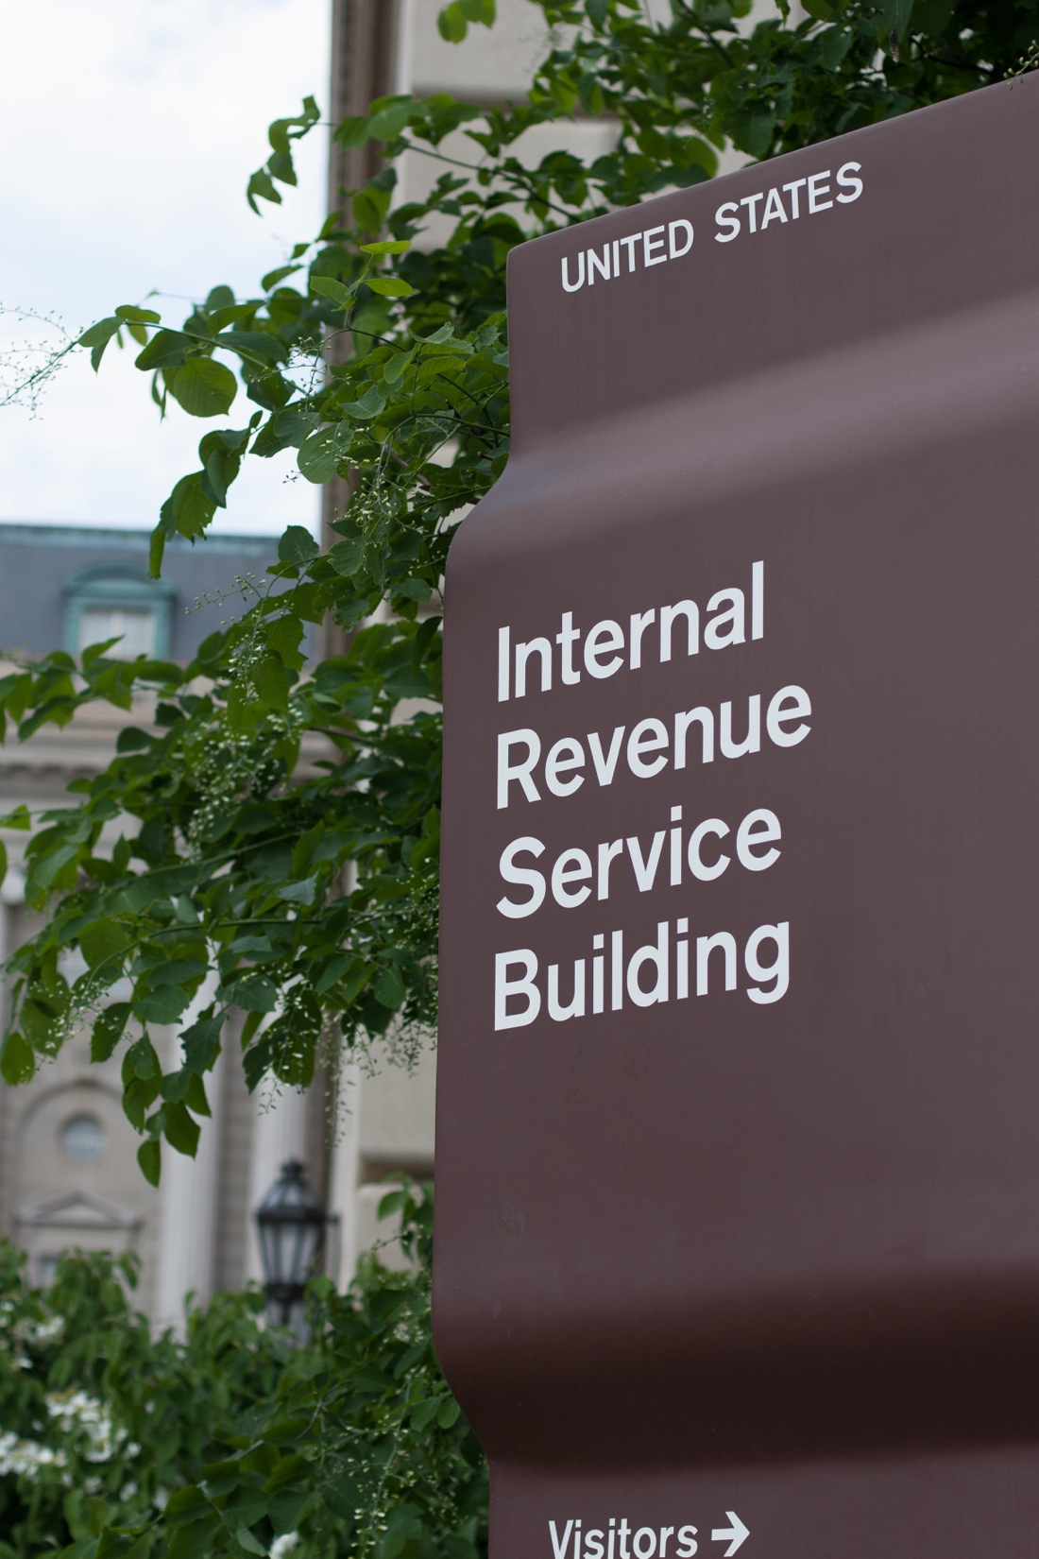
REMEMBER!
Keep all IRS correspondence FOREVER.
DO NOT ignore any IRS notices.
Financial Officer Guidelines | November 2024

Slide 27
District Roster
Maintain a current roster of Zones and Groups.
Contact name of Zone/Group President
Address
Phone number
Email address
Submit roster to LWML office on or before January 1 of each year.

Slide 28
RISK MANAGEMENT

Slide 29
Minimizing Risk
Events
Notify Lutheran Trust for these events:
Runs/Walks that are on public/city streets
Taking kids to a camp
Movie/Video making/production
Convention events which include childcare
Internal Controls
Segregate duties to prevent misuse/misappropriation of assets.
Crime Coverage
District volunteers covered under an Employee Dishonesty Bond (limit of $20,000 per occurrence)
Does not include Zone/Group volunteers

Slide 30
MITE OFFERINGS

Slide 31
Mite Offering Remittances
Group
Remit mite offerings to zone or district per the payment structure within your district.
Zone
Remit to district mite offerings.
District
Remit 25% of mite offerings received monthly to LWML National Office.
Remittances must be accompanied by a District Remittance Voucher.

Slide 32
District Remittance Voucher
ALWAYS!
Include a voucher with any checks sent to the LWML office
Email the LWML Treasurer a copy of the Voucher

Slide 33
Electronic Remittance of Mite Offerings
ONLY for MITES
District Mite Offering Electronic Remittance Form
Complete form
PAY
Receive confirmation email
Forward confirmation email to LWML Treasurer

Slide 34
PAYMENTS TO LWML NATIONAL

Slide 35
Invoices
Districts will receive invoices from the LWML offices for:
Liability Insurance
Lutheran Woman’s Quarterly Subscriptions
Travel Expenses
Name Badges and LWML Merchandise
Districts are expected to pay invoices upon receipt.

Slide 36
LEGACY GIFTS

Slide 37
‘le-gə-sē’ ˈg ift
A legacy gift is a planned future gift that designates some part of an individual’s estate as a donation to LWML or an LWML District.

Slide 38
Legacy Gift Processing
Donor inquiries should be provided the following wording:
The Lutheran Women’s Missionary League _____ District, federal tax identification number of the LWML district #____, named in care of the Lutheran Women’s Missionary League, 801 Seminary Place, Suite L010, St. Louis, MO 63105.
The LWML Office will forward the actual check received directly to the district via the current district president’s address.

Slide 39
Quick Break!
5-minute break
Question & Answer Session is next!
Type your question in the “Chat Box”
Include your Name and District
Will answer as many as time permits

Slide 40
Do you still have questions?
Email: treasurer@lwml.org

