Slide 1
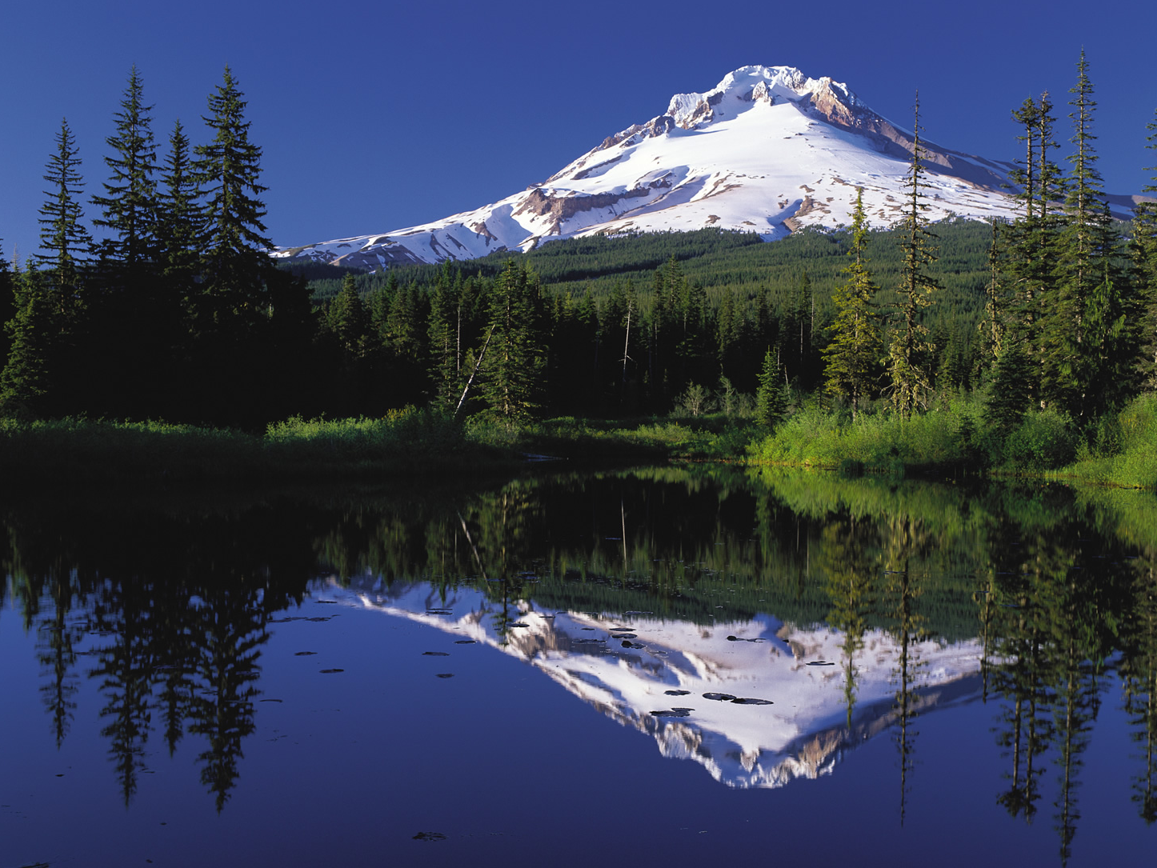

Slide 2


Slide 3
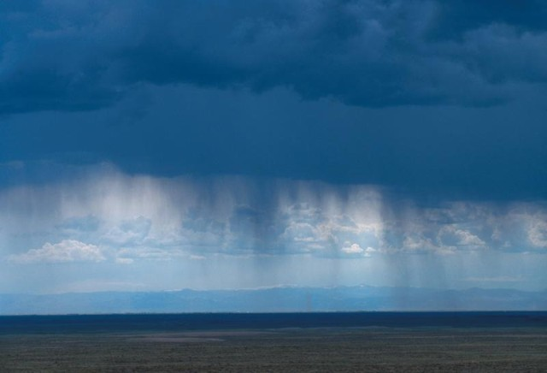

Slide 4
Praise God from whom
all blessings flow,
Praise Him all creatures
here below,
Praise Him above
ye heavenly hosts,
Praise Father, Son,
and Holy Ghost. Amen!

Slide 6
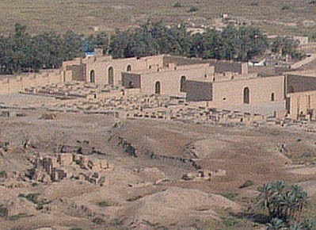

Slide 8
The “None” Zone

Slide 10
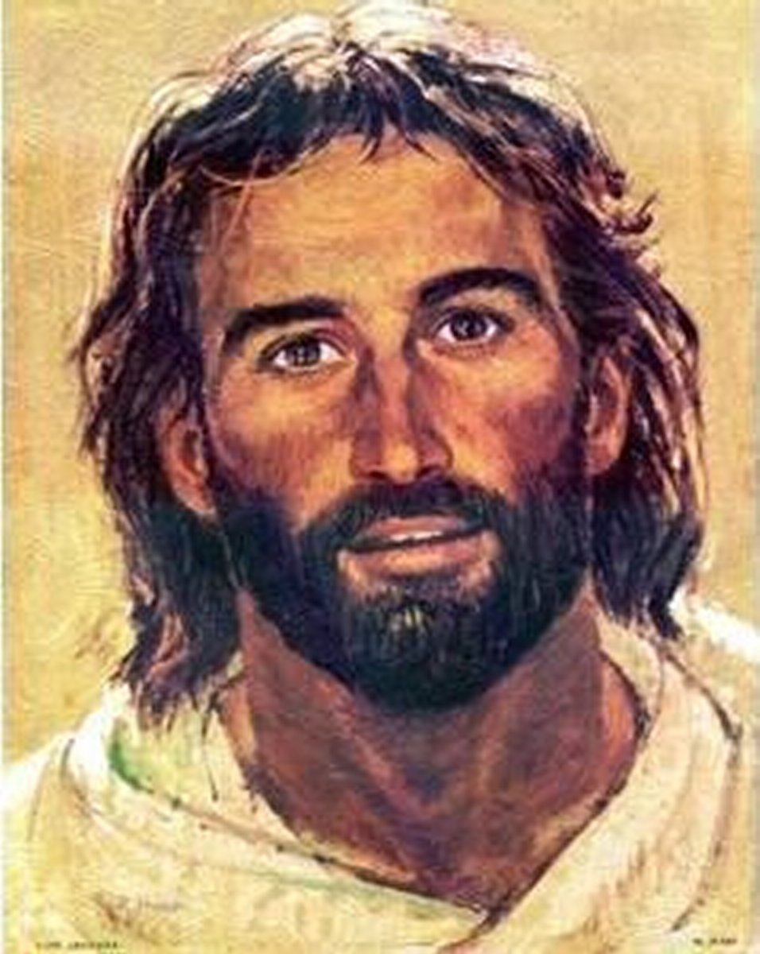

Slide 12
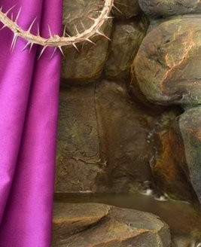

Slide 13
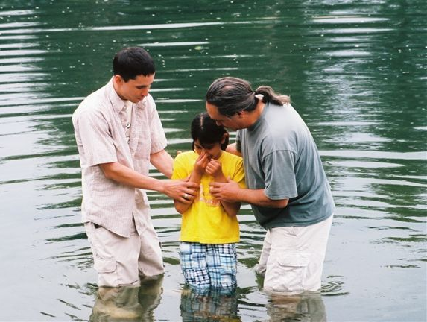
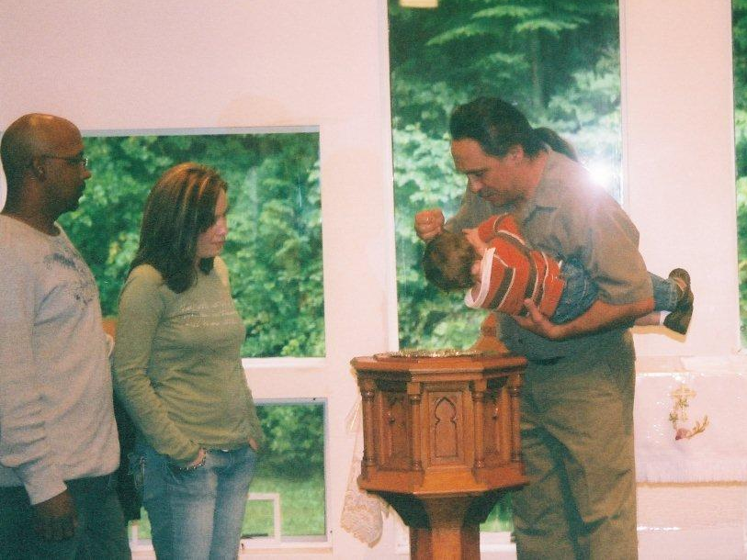
Water and the Word

Slide 14
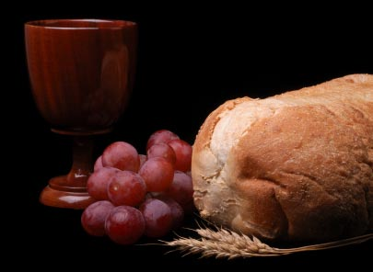

Slide 15
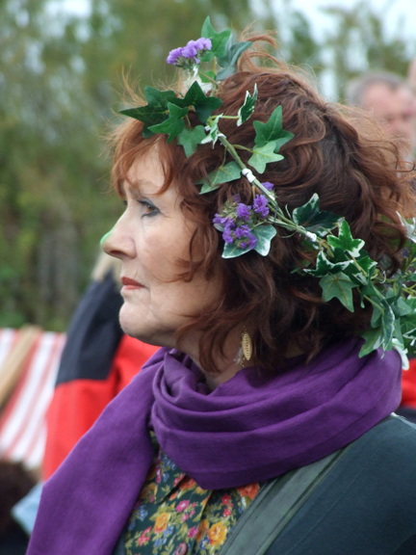

Slide 16


