Slide 1



Pentecostals*
Modern History and Beliefs
*From a Lutheran View

Slide 2
Pentecostal Church Bodies
  Apostolic Church
  Assemblies of God
  Association of Vineyard Churches
  Church of God (Cleveland)
  Church of God in Christ
  Church of God of Prophecy
  Elim Pentecostal
  Full Gospel Baptist Church Fellowship
  Hillsong Church
  International Church of the Foursquare Gospel
  International Pentecostal Holiness Church
  Pentecostal Assemblies of the World
  United Pentecostal Church International (UPCI)

Slide 3
Statistics
Unlike other churches, Pentecostalism is NOT a unified church but rather mentioned as a “movement” within the broader church. For this reason, numbers are difficult to fully nail down as there is no international church body for all Pentecostal churches. Rather, many operate independently of church structure or are considered “non-denominational”.
Despite this, a Pew Research poll (2011) has estimated roughly 279 million “classical” Pentecostals, or combined with charismatic Christianity, as many as 600-700 million worldwide.
  **These numbers are said to include those in other church bodies who adhere to Pentecostal teachings.
The largest single “Pentecostal” church body is the Assemblies of God who have an estimated worldwide membership of 67-86 Million, or in the USA of 2.98 million.

Slide 4
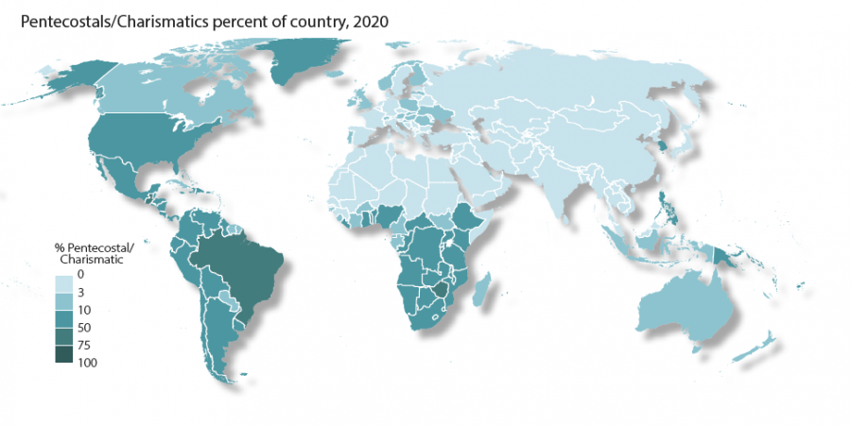

Slide 5
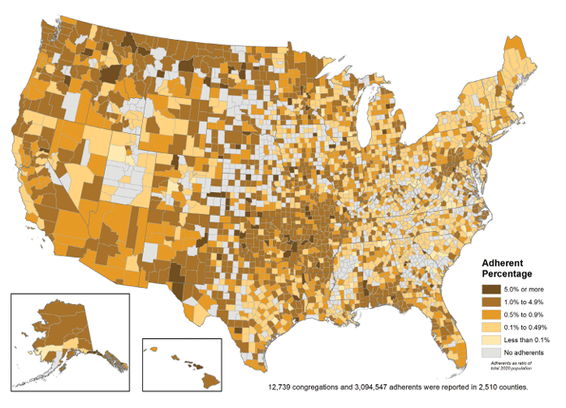
Assemblies of God
Adherents as a percentage of Total Population,
2020
Source:
US Religion Census

Slide 6
What does it mean to be:
A *Pentecostal?
Again, since Pentecostalism is not a true independent church body, it is difficult to simplify to one denomination. There are no defining documents for Pentecostals as many will say the bible alone is authoritative.
However, the main teachings of the Pentecostal church are:
  the teaching of “baptism in the Holy Spirit”
  Presence of Spiritual gifts as evidence of this baptism in the Holy Spirit.
  A holiness of living which is empowered by the Baptism in the Holy Spirit.
Since it is impossible to summarize every “Pentecostal” church body, we will focus on the Assemblies of God.
  At it’s formation in 1908, the Assemblies of God wrote 16 fundamental doctrines.
  They have further clarified this with their four core doctrines being Salvation, Baptism in the Holy Spirit, Divine Healing, and the Second Coming of Christ.

Slide 7
History
Most Pentecostal church bodies will trace their history back to 20th century (1901) adherents of the Wesleyan-Holiness movement.
Charles Parham (an American evangelist and faith healer) and William J. Seymour (a Wesleyan-Holiness preacher) began teaching that speaking in tongues was the evidence of Spirit baptism, calling this the “third work of grace”.
  The prominent event is the three-year-long Azusa Street Revival in Los Angeles, CA which is where Pentecostalism firmly distinguishes itself from other movements or churches.
Due to early disputes concerning the doctrine of entire sanctification and (later) the Holy Trinity, Pentecostalism is divided into three different branches, namely Holiness Pentecostals (main), and Finished Work Pentecostals, with an offshoot being Oneness Pentecostals.
Notes:
3 Works of Grace- salvation, entire sanctification, baptism in the Spirit

Slide 8
History
Aside from Parham and Seymour, other notable figures that arose in this Pentecostal movement include Dwight L. Moody, R.A. Torrey, Albert Benjamin Simpson, and John Alexander Dowie.
  This is one of the biggest reasons why Pentecostalism is decentralized and not joined into one church body. Each “evangelist” would hold their own sphere of influence and many began their own schools of teaching.
Many Bible colleges arise from these figures including Bethel Bible College (Parham) and Moody Bible Institute.

Slide 9
Divisions within Pentecostalism
Because of the numerous voices arising within Pentecostalism in the early years (particularly coming from different church bodies), disagreements arose over the teaching of entire sanctification (a Methodist teaching).
The main Pentecostal branch is called Holiness Pentecostalism which hold to the three works of grace. Those that disagreed with this teaching became the “Finished Work Pentecostals” who teach that one grows in grace throughout life instead of it being instantaneous with conversion.
Further division arose among the “Finished Work Pentecostals” over the doctrine of the Trinity. Some would come to deny the teaching of the Trinity which gave rise to “Oneness Pentecostalism”.

Slide 10
Main Beliefs
Again, while it is impossible to summarize all of Pentecostalism together, the following teachings are generally followed by most churches within the movement. Specific teachings will be taken from the Assemblies of God for reference.
  Baptism in the Holy Spirit (in addition to water baptism) is necessary for all Christians and should be sought.
  Evidence of this Baptism include speaking in tongues, holiness of living, faith healings, and dedication to God’s work.
  Belief in the imminent Second-coming of Christ (eschatology is primarily premillennialism)
  Sanctification is “an act of separation from that which is evil, and of dedication unto God” (ag.org)

Slide 11
Comparison
 | (Pentecostalism*) Assemblies of God | Lutheran
Sacraments | Baptism and Lord’s Supper, but are purely symbolic *Feet washing | Baptism and Lord’s Supper, are the means by which God gives grace and salvation.
Speaking in Tongues | Is the initial physical sign of baptism in the Holy Spirit to be sought by every Christian | Was given to the apostles for a time as evidence of God’s work in the Church, but is no longer present.
Eschatology | Premillennialism- The Rapture, Christ’s 1000 year reign with the saints, then final judgment. | Amillennialism- Symbolic for the Christ’s eternal reign over heaven and earth, Christ will return for final judgment.

