Slide 1

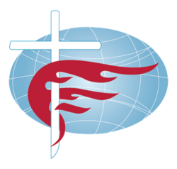
Methodists
Modern History and Belief
*From a Lutheran view

Slide 2
Statistics
Methodists rank within the top 10 of the largest Protestant church bodies with an estimated 80 million followers globally. The World Methodist Council represents the majority of Methodist churches around the world, consisting of 81 denominations and 138 countries.
The main Methodist denomination is the United Methodist Church (UMC) which is a worldwide entity but is based in the USA. It has an estimated 9.9 million (USA) members as of 2022.
Population of Methodists by country:
#1 United States | 9.9 million | DR of Congo | 2.9 million
#2 Nigeria | 3.3 million | South Korea | 2.2 Million
#3 India | 3.1 Million | South Africa | 1.6 million

Slide 3
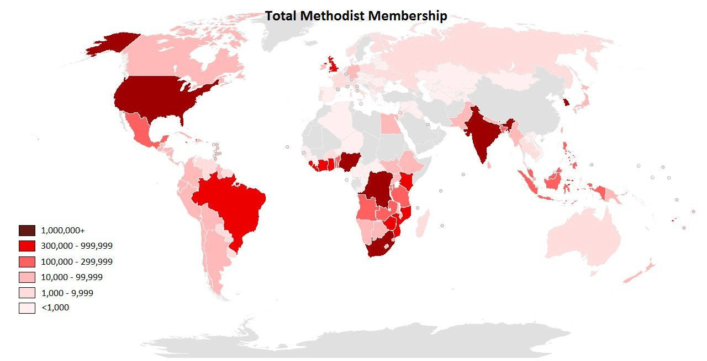
As of 2018
Notes:
Map c. 2018

Slide 4
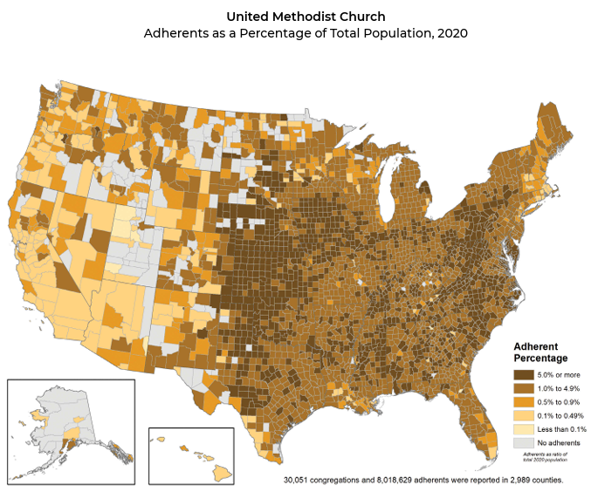
United Methodist Church Adherents as a Percentage of Total Population, 2020
Source:
US Religion Census

Slide 5
What does it mean to be:
Methodist?
The name Methodists comes from the “methodical” way in which they carried out their Christian faith.
Methodists follow the teachings of John Wesley (b.1703-d.1791) who was an Anglican minister. Wesley and others sought further reform of the Anglican church, but would eventually break with the church following Wesley’s death.
Some important documents include:
  (25) Articles of Religion [re-written from the 39 Articles of Religion in the Anglican Church]
  The Confession of Faith (1968)
  [John] Wesley’s Sermons and Notes on the New Testament
Methodists were well known for their small-group revivalism, which was a key feature of early Methodism.

Slide 6
History
Following the establishment of the Church of England and the reforms undertaken there, John Wesley (and his brother, Charles Wesley) would notice a lack of religiosity within the Church. John Wesley was an Anglican minister (c.1730s).
After traveling to America to be missionaries to the Native Americans, the Wesley brothers would return to England where they would attend a Moravian Church service on Aldersgate (May 24, 1738). It was at this service that John Wesley would have his “religious experience” upon hearing Luther’s preface on the Epistle to the Romans.
Following his “Alders-Gate” experience, Wesley sets out to preach and teach to individuals and groups in houses, religious societies, and in the few churches that had not closed their doors to evangelical preachers.

Slide 7
History
While much of the early history of what would become the Methodist church was within the Anglican Church, a split would form following the American Revolution.
  In 1784, Wesley would ordain preachers for America with the power to administer the Sacraments.
  The Church of England held that such power to ordain was restricted to the bishops.
Like other Church bodies we’ve studied, the period of the Second Great Awakening (1817-1843) brought great growth to the Methodist Church.
Within the United States, the United Methodist Church was founded in 1968 as a merger between the Methodist Episcopal Church and the Evangelical United Brethren Church.

Slide 8
Beliefs
Coming from the Anglican tradition, Wesley was influenced by Lutheran theology. In addition, John Wesley was greatly opposed to Calvinist theology present in the Church of England, seeking to remove it’s influence in his re-write of the Articles of Religion.
Methodists hold to all traditional Christian teachings (ex. Trinity, Incarnation, Salvation through faith, Holy Scripture, etc.).
One of the big defining features of Wesley’s theology was the emphasis on the experience of faith, or the presence of both internal and external holiness. Hence, the name Methodists come from Wesley’s proposed methods for which one is to live out the Christian faith.
  For this reason, small groups were foundational to the development of the Methodists. Within the group, you would share your witness and also have a group accountability and support.

Slide 9
Beliefs
Methodists believe:
  Man is wholly sinful and is “destitute of holiness and inclined to evil” (Confession of Faith Ar. VII)
  Righteousness is by faith alone in Jesus Christ... “We believe regeneration is the renewal of man in righteousness through Jesus Christ, by the power of the Holy Spirit, whereby we are made partakers of the divine nature and experience newness of life. By this new birth the believer becomes reconciled to God and is enabled to serve him with the will and the affections,” (Confession of Faith Ar. IX)
  Sanctification is “the work of God’s grace through the Word and Spirit”. It is possible to attain to the state of “perfect love”, however, such experience “does not deliver us from the infirmities, ignorance, and mistakes common to man, nor from the possibilities of further sin.” (Confession of Faith Ar. XI)
  “We believe the Lord's Day is divinely ordained for private and public worship, for rest from unnecessary work, and should be devoted to spiritual improvement, Christian fellowship and service.” (Confession of Faith Ar. XIV)

Slide 10
Comparison
 | Methodist | Lutheran
Sanctification | God’s work in us, but enables us to fully uphold God’s law. To be sanctified means being free of all outward sin. | God works in us through faith the good works which he desires, though we are never free of sin. (AC VI)
Ministry | Emphasis on ministry of laity and their obligation to “use” gifts for Christ. | “No one may teach, preach, or administer the Sacraments unless properly called” AC XIV
Social issues | Affirms LGBTQ+, supports women’s ordination, etc. | Does not condone LGBTQ, women’s ordination, etc.
Notes:
“Ordained ministers are called to interpret to the Church the needs, concerns, and hopes of the world and the promise of God for creation” (Book of Discipline, par. 138)

