Slide 1

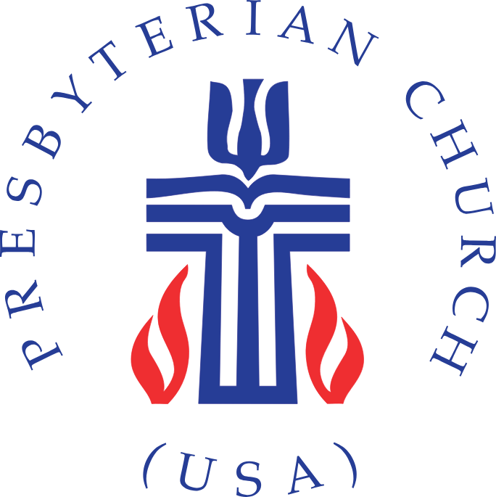

Presbyterian
Recent History and Modern Beliefs
*From a Lutheran View*

Slide 2
Statistics
Presbyterians make up part of the Reformed Church, taking after the traditions of John Calvin. The total membership of the Presbyterian church worldwide is estimated around 50 million, or total of Reformed Churches is around 100 million.
In America, the mainline Presbyterian church is the Presbyterian Church (U.S.A) [PC(USA)] which reports membership around 1 million. Other notable church bodies include Presbyterian Church in America (PCA) [400k members], and the Evangelical Presbyterian Church (EPC) [119k members].
The majority of Presbyterians are concentrated in a few key regions, with the United States, South Korea, and Scotland having the largest Presbyterian populations.

Slide 3
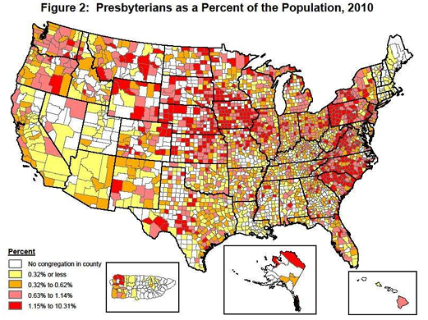

Slide 4
What does it mean to be:
Presbyterian
Presbyterians are characterized by:
  Particular church governance structure of having “presbyters” as leaders of the church
  Westminster Confession of Faith (Reformed)- 1646
  Westminster catechisms- 1646
Some will also adhere to:
  Scots Confession (1560)
  Heidelberg Catechism (1563)
  Second Helvetic Confession (1566)
Due to their church structure, different Presbyterian churches will have different documents to which they subscribe.

Slide 5
History
Presbyterianism rises mainly out of the Church of Scotland from the leadership of John Knox in 1560. This comes among the push for Scottish independence and later including dissenters from the English Civil War in 1642-1651.
  Note that Presbyterianism is a branch of the Reformed church with the name of the church representing a church-governance structure rather than theology.
  John Knox as the leader of the church in Scotland follows the tradition of John Calvin, having studied with him in Geneva.
With the summoning of the Westminster Assembly in 1646, John Knox writes a confession of faith which is later voted for the Assembly’s stance in the Church of England. This is adopted as the national Church of Scotland after it’s adoption by the Assembly.

Slide 6
History- America
Immigrants from Scotland, England, and Ireland would bring Presbyterianism to the US with the first presbytery formed in 1706, which would later become the PCUSA.
Like Baptists, the Civil War would cause divisions in the Church along northern and southern lines. However, these church bodies would later be reunited in 1983 as the Presbyterian Church (U.S.A).
The Presbyterian Church would be play a significant role in the Second Great Awakening (1795-1835) by sending missionaries to the frontiers and would also see great growth from the endeavor.

Slide 7
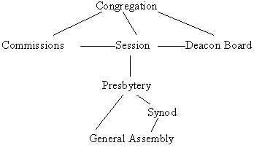
Church Governance
One of the most notable features of the Presbyterian Church is their church structure. They would repudiate the episcopal structure of the Catholics and Anglicans, but also decry the congregationalism present in other Protestant church bodies.
Similar to a representative democracy, each congregation will elect leaders (elders/presbyters) to “session”, which is the governing body of the local congregation.
From the Session, the body would send a delegate to the local (“Presbytery”), regional (“Synod”), and National (“General Assembly”) assemblies.

Slide 8
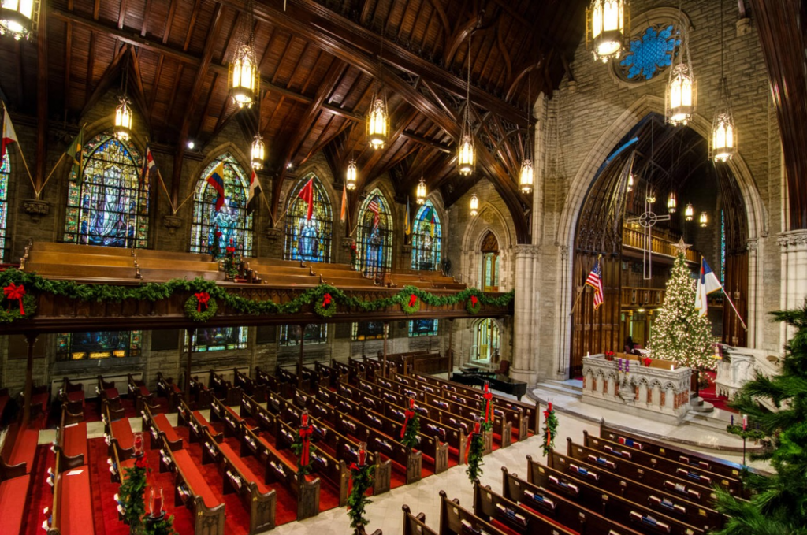
First Presbyterian Church of Pittsburgh
PCUSA Church

Slide 9
Main Beliefs
Presbyterians follow many of the same beliefs as other Reformed churches. The main framework of their beliefs is the acronym T.U.L.I.P (discussed last week).
  Total depravity, Unconditional Election, Limited Atonement, Irresistible Grace, Perseverance of the Saints.
Presbyterians hold to two Sacraments, namely Baptism and the Lord’s Supper.
  Presbyterians baptize infants by sprinkling or pouring water over the head. They reject immersion as a form of baptism.
  In line with their Reformed tradition, Christ’s presence in the Sacrament is only through a “spiritual” presence. Though, since they do not believe that the Lord’s Supper is a reenactment of the Last Supper, they will have a separate table at which to communion, rather than an altar.

Slide 10
Modern Social Issues
Like most Protestant Church bodies in America, divisions amongst a church body occur over differing opinions concerning modern social issues, including LGBTQ+, racism, women’s ordination, and other social justice issues.
The mainline Presbyterian Church (PCUSA) follows a more liberal stance towards these issues, fully supporting LGBTQ issues, advocating against “systemic racism”, supporting women’s ordination within their churches, etc.
Yet, other church bodies have broken from the PCUSA, holding a more conservative stance. Such bodies include the Presbyterian Church in America (PCA), the Evangelical Presbyterian Church (EPC), and others.

Slide 11
Comparison
 | Presbyterian | Lutheran
Lord’s Supper | Spiritual Presence | Bodily Presence
Predestination | Holds to Reformed Tradition: God predestines to heaven and hell. | God has predestined to salvation- sending Christ and establishing the Church.
Sacraments | Are a “sign and seal” of the covenant of Grace. | Are the means by which God gives us his grace and strengthens our faith.

